Slide 1
“Thirty Pieces Of Silver”
Zechariah 11:12-13; Matthew 26:15; 27:3, 9

Slide 2
Background
Who Was Judas?
  Judas was one of the twelve selected.
  As an apostle, he walked with Jesus every day during His earthly ministry.
  He heard Jesus’ teaching about God, witnessed the miracles He performed, and saw the character of the only perfect man ever to have lived.
  He saw the glory of God incarnate. John 1:14; 14:9
  Judas had broken God’s law. Exodus 23:7, “Keep thee far from a false matter; and the innocent and righteous slay thou not”
  Judas was a devil. John 6:70-71
  Judas was a thief. John 12:6
  Satan entered his heart. Luke 22:3; John 13:2

Slide 3
Background
Context? Matthew 26:6-13, Mark 14:3-9,
and John 12:2-8
Jesus went to supper at the home of a leper named Simon in Bethany. Lazarus, “whom Jesus raised from the dead,” was there with his sisters.
Martha served the meal and Mary “anointed the feet of Jesus, and wiped his feet with her hair.”

Slide 4
Background
Judas Iscariot objected to what he considered wasted, valuable ointment which could have been sold for three hundred pence.
John 12:4
  His objection was because he was a thief. John 12:5-6
  He was covetous. Jesus rebuked Judas, “Let her alone; why trouble ye her? she hath wrought a good work on me. For ye have the poor always with you, and whensoever ye will ye can do them good: but me ye have not always. She hath done what she could; she hath anointed my body beforehand for the burying. And verily I say unto you, Wheresoever the gospel shall be preached throughout the whole world, that also which this woman hath done shall be spoken of for a memorial of her.”
  Mark 14:6-9
Judas asked the chief priests, “What will ye give me, and I will deliver him unto you?” Matthew 26:15

Slide 5
What Thirty Pieces of Silver Could Buy …
Sufficient sum legislated by the law of Moses as payment for a slave who had been gored by an ox. Exodus 21:32
Sufficient to buy the betrayal of Jesus into their hands.
cf. Matthew 16:26, “Then said Jesus unto his disciples, If any man would come after me, let him deny himself, and take up his cross, and follow me. For whosoever would save his life shall lose it: and whosoever shall lose his life for my sake shall find it. For what shall a man be profited, if he shall gain the whole world, and forfeit his life? or what shall a man give in exchange for his life?”
Sufficient to buy a field to bury strangers in.
Matthew 27:6-8
Potter’s field: “a public burial place for paupers, unknown persons, and criminals” (Webster)

Slide 6
What Thirty Pieces of Silver Could NOT Buy …
Thirty pieces of silver could not redeem Christ from death.
  Note: Matthew 26:36-39, 47-50, 56
  Thursday night into early Friday morning: Jesus was arrested and tried before Caiaphas.
  Matthew 26:47-75
  Friday morning: Jesus was brought before Pilate. Matthew 27:1-2
  Judas learned that his accomplices were willing to go much further than he was ready to go.

Slide 7
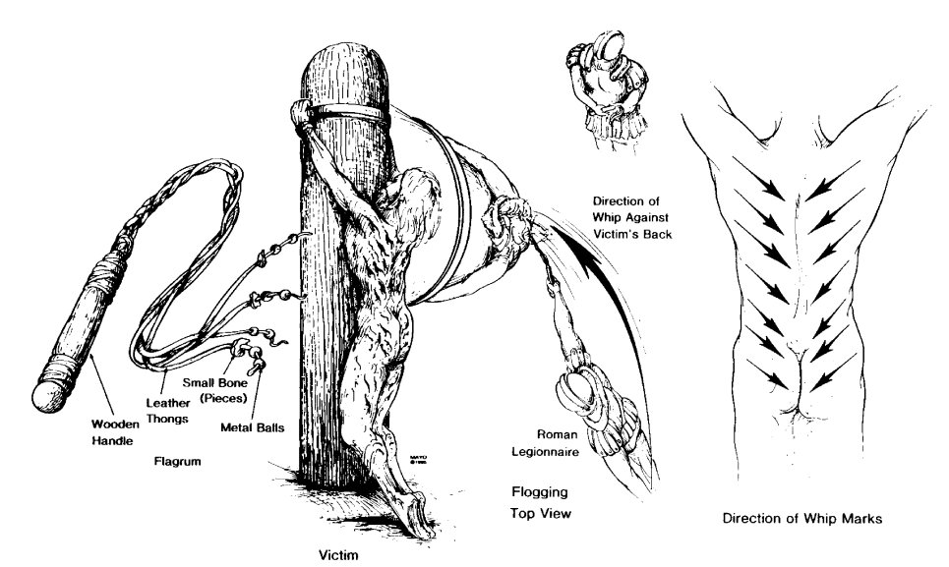
Thirty Pieces of Silver Could NOT stop this…

Slide 8
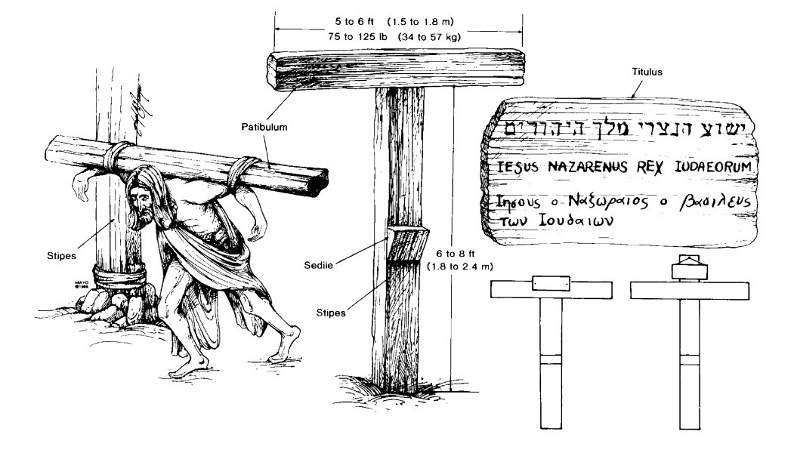

Slide 9
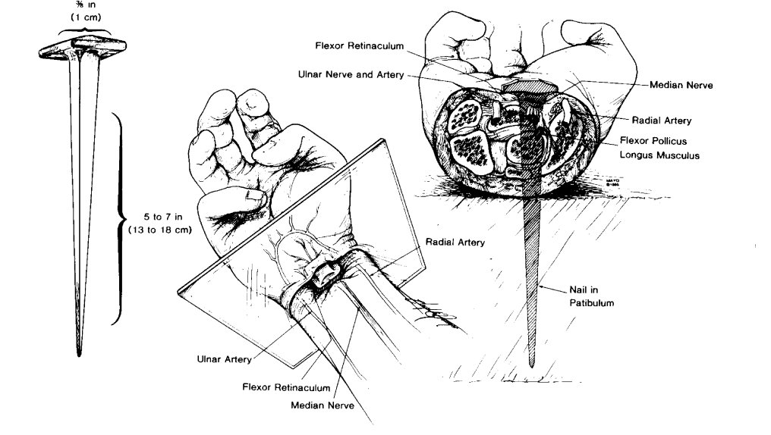
Figure 4. Nailing of wrists. Left, Size of iron nail. Center, Location of nail in wrist, between carpals and radius. Right, Cross section of wrist, at level of plane indicated at left, showing path of nail, with probable transection of median nerve and impalement of flexor pollicis longus, but without injury to major arterial trunks and without fractures of bones.

Slide 10
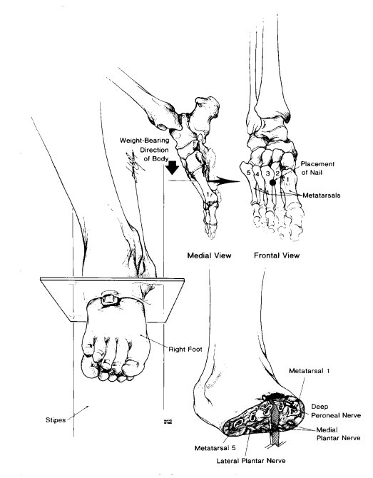
Figure 5. Nailing of feet. Left, Position of feet atop one another and against stipes. Upper right, Location of nail in second intermetatarsal space. Lower right, Cross section of foot, at plane indicated at left, showing path of nail.

Slide 11
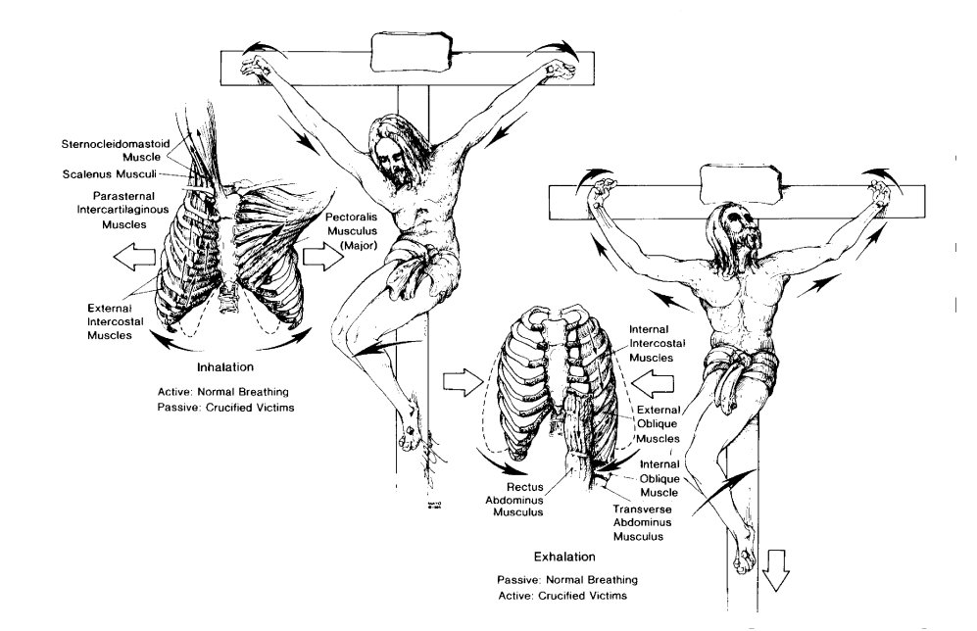
Figure 6. Respirations during crucifixion. Left, Inhalation. With elbows extended and shoulders abducted, respiratory muscles of inhalation are passively stretched and thorax is expanded. Right, Exhalation. With elbows flexed and shoulders adducted and with weight of body on nailed feet, exhalation is accomplished as active, rather than passive, process. Breaking legs below knees would place burden of exhalation on shoulder and arm muscles alone and soon would result in exhaustion asphyxia.

Slide 12
What Thirty Pieces of Silver Could NOT Buy …
Thirty pieces of silver could not buy concern for Judas’ soul from the leaders of the Jews.
  When Judas returned with his money and said, “I have betrayed innocent blood,” the Jewish leaders said, “What is that to us? See thou to it.” Matthew 27:4
  Sin always promises more than it can deliver. It promises liberty, but brings bondage. 2 Peter 2:18-19
    Adam and Eve. Genesis 3
    Achan. Joshua 6-7
    King Saul. 1 Samuel 13-15
    King David. 2 Samuel 11-12

Slide 13
What Thirty Pieces of Silver Could NOT Buy …
Thirty pieces of silver could not buy a clear conscience. Matthew 27:3-5
  Only the gospel of peace can give one the peace that passes all understanding. Philippians 4:7; Acts 9:6-9; 1 Peter 3:21
Thirty pieces of silver could not redeem Judas from hell. John 17:12; Matthew 26:24

Slide 14
What Thirty Pieces of Silver Could NOT Buy …
Conclusion:
A. There are some things that thirty pieces of silver cannot buy.
B. Neither could thirty thousand pieces of silver have bought what these thirty pieces of silver could not buy.
C. May we learn the lessons from the sin of Judas that we not fall into similar condemnation.

